Slide 1
High-level Language 1: Pig Latin
2008 SIGMOD: From Yahoo Research (Olston, et. al.)
Apache software - main teams now at Twitter & Hortonworks
Common ops as high-level language constructs
e.g. filter, group by, or join
Workflow as: step-by-step procedural scripts
Compiles to Hadoop

Slide 2
What is Apache Pig?
Apache Pig is nothing but a data flow language. It is built on top of Hadoop. Basically, without having to write vanilla MapReduce jobs, it makes easier to process, clean and analyze “Big Data” in Hadoop.
In addition, it has a lot of relational database features. Moreover, commands like good old joins, distinct, union and many more are already in the language. To be specific, Pig solves differently than the relational database, so it is applicable to “big data” where it can crunch large files with ease and it does not need a structured data.

Slide 3
Also, we can use Pig for ETL(Extraction Transformation Load) tasks naturally as it can handle unstructured data.

Slide 4
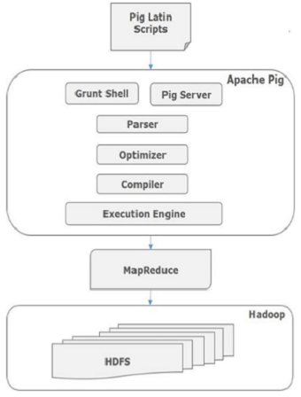
Architecture of Pig

Slide 5
Explanation
Parser
Initially the Pig Scripts are handled by the Parser. It checks the syntax of the script, does type checking, and other miscellaneous checks. The output of the parser will be a DAG (directed acyclic graph), which represents the Pig Latin statements and logical operators.
Optimizer
The logical plan (DAG) is passed to the logical optimizer, which carries out the logical optimizations such as projection and pushdown.

Slide 6
Compiler
The compiler compiles the optimized logical plan into a series of MapReduce jobs.
Execution engine
Finally the MapReduce jobs are submitted to Hadoop in a sorted order. Finally, these MapReduce jobs are executed on Hadoop producing the desired results.

Slide 7
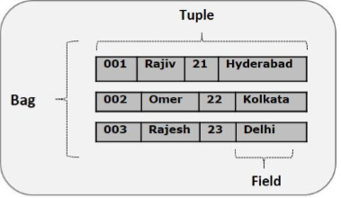
Pig Latin Data Model

Slide 8
Pig Latin Example
visits = load ‘/data/visits’ as (user, url, time);
gVisits = group visits by url;
urlCounts = foreach gVisits generate url, count(visits);
urlInfo = load ‘/data/urlInfo’ as (url, category, pRank);
urlCategoryCount = join urlCounts by url, urlInfo by url;
gCategories = group urlCategoryCount by category;
topUrls = foreach gCategories generate top(urlCounts,10);
store topUrls into ‘/data/topUrls’;

Slide 9
Pig Latin Example
visits = load ‘/data/visits’ as (user, url, time);
gVisits = group visits by url;
urlCounts = foreach gVisits generate url, count(visits);
urlInfo = load ‘/data/urlInfo’ as (url, category, pRank);
urlCategoryCount = join urlCounts by url, urlInfo by url;
gCategories = group urlCategoryCount by category;
topUrls = foreach gCategories generate top(urlCounts,10);
store topUrls into ‘/data/topUrls’;
Operates directly over files

Slide 10
Pig Latin Example
visits = load ‘/data/visits’ as (user, url, time);
gVisits = group visits by url;
urlCounts = foreach gVisits generate url, count(visits);
urlInfo = load ‘/data/urlInfo’ as (url, category, pRank);
urlCategoryCount = join urlCounts by url, urlInfo by url;
gCategories = group urlCategoryCount by category;
topUrls = foreach gCategories generate top(urlCounts,10);
store topUrls into ‘/data/topUrls’;
Schemas optional;
Can be assigned dynamically

Slide 11
Pig Latin Example
visits = load ‘/data/visits’ as (user, url, time);
gVisits = group visits by url;
urlCounts = foreach gVisits generate url, count(visits);
urlInfo = load ‘/data/urlInfo’ as (url, category, pRank);
urlCategoryCount = join urlCounts by url, urlInfo by url;
gCategories = group urlCategoryCount by category;
topUrls = foreach gCategories generate top(urlCounts,10);
store topUrls into ‘/data/topUrls’;
User-defined functions (UDFs) can be used in every construct
Load, Store
Group, Filter, Foreach

Slide 12
Pig Latin Execution
visits = load ‘/data/visits’ as (user, url, time);
gVisits = group visits by url;
urlCounts = foreach gVisits generate url, count(visits);
urlInfo = load ‘/data/urlInfo’ as (url, category, pRank);
urlCategoryCount = join urlCounts by url, urlInfo by url;
gCategories = group urlCategoryCount by category;
topUrls = foreach gCategories generate top(urlCounts,10);
store topUrls into ‘/data/topUrls’;
MR Job 1
MR Job 2
MR Job 3

Slide 13
Pig Latin: Execution
Visits(User, Url, Time)
UrlInfo(Url, Category, PageRank)
visits = load ‘/data/visits’ as (user, url, time);
gVisits = group visits by url;
visitCounts = foreach gVisits generate url, count(visits);
urlInfo = load ‘/data/urlInfo’ as (url, category, pRank);
visitCounts = join visitCounts by url, urlInfo by url;
gCategories = group visitCounts by category;
topUrls = foreach gCategories generate top(visitCounts,10);
store topUrls into ‘/data/topUrls’;
MR Job 1: group by url + foreach
UrlCount(Url, Count)
MR Job 2:join
UrlCategoryCount(Url, Category, Count)
MR Job 3: group by category + for each
TopTenUrlPerCategory(Url, Category, Count)
13

Slide 14
Working with pig

Slide 15
Pig environment
Web site: pig.apache.org
Download the latest version, unzip, and move to an appropriate directory.
Setup your path
In .profile or .bashrc
export JAVA_HOME=/to/java/installation
Add pig’s bin directory to your PATH (optional)

Slide 16
Two modes to run pig
Interactive modes
Local: “pig –x local”
Hadoop: “pig –x mapreduce”, or just “pig”
batch mode: all commands in one script file.
Local: “pig –x local your_script”
Hadoop: “pig your_script”

Slide 17
Advantages of Pig
Less development time
Easy to learn
Procedural language
Dataflow
Easy to control execution
UDFs
Lazy evaluation
Usage of Hadoop features
Effective for unstructured
Base Pipeline

Slide 18
Apache Pig disadvantages
Errors of Pig
Not mature
Support
Minor one
Implicit data schema
Delay in execution

